Slide 1
Out of this world: constructing languages for fiction, film, and fun
Laura A. Janda
Scripts
Nouns (part 1)
February 10, 2023 Session A

Slide 2

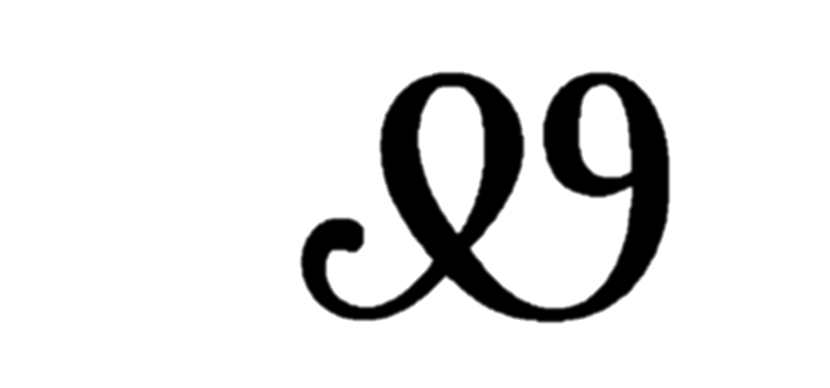
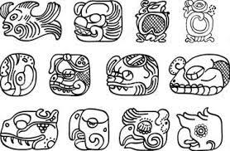
Scripts = writing systems = orthographies
Three most common solutions
Alphabet: graphemes (letters) represent sounds
Most European and Middle Eastern languages, Korean
Syllabary: graphemes represent syllables
Japanese, Cree, Mycenaean Greek, Cherokee
Logography: graphemes (logograms) represent morphemes (semantic units, words)
Chinese, Egyptian hieroglyphs, Mayan
A writing system is NOT an obligatory part of language; most languages don’t have one
Clip: Conlanging 20:29-26:11

Slide 3

Questions and Comments?

Slide 4
Nouns:
Number
Singular, dual, plural
Count nouns and mass nouns
Classifiers
Animacy
Definiteness
Indefinite and definite
Grammatical gender
Table
Chair
Telephone
Sand
Wine
air
All these words are NOUNS!
Internship
Love
Generalization

Slide 5
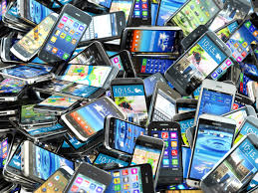
What is going on here?
Insert the word telephone in the sentences:
There was a ___________ on the table.
telephone
There were five __________ on the table.
telephoneS
There were many ___________ on the table.
telephoneS
But there are many other ways of marking number!
Number:
In many languages, nouns have differents forms for singular (one item) and plural (more than one item).
Often, plural has a suffix, while singular does not.

Slide 6
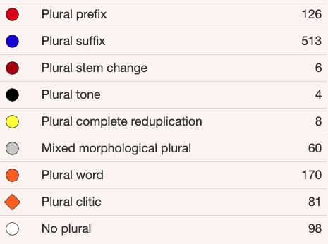
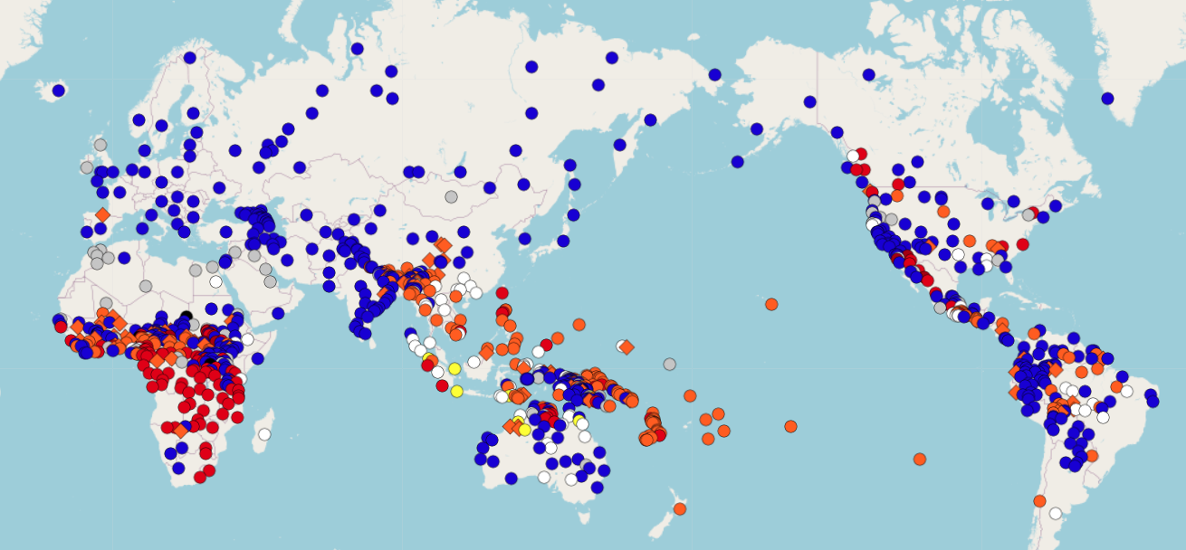
WALS: Coding of Nominal Plurality
SUFFIX
WORD/ CLITIC
PREFIX

Slide 7
Questions and Comments?

Slide 8
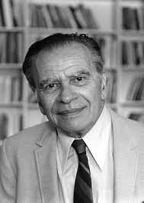
More on number: not just singular and plural
Number Hierarchy:
Singular
>
plural
>
Dual
>
Trial/paucal
Singular:
One item
Dual:
Two items (e.g. Upper Sorbian (Germany))
Trial:
Three items (e.g. Larike (Austronesia))
Paucal:
A few items (Yimas (Papua New Guinea))
Plural:
Many items
No language has a trial or paucal number unless it has a dual. No language has a dual unless it has a plural.
Joseph Greenberg (1915-2001):
Father of linguistic universals
Notes:
After Corbett Number p. 39

Slide 9
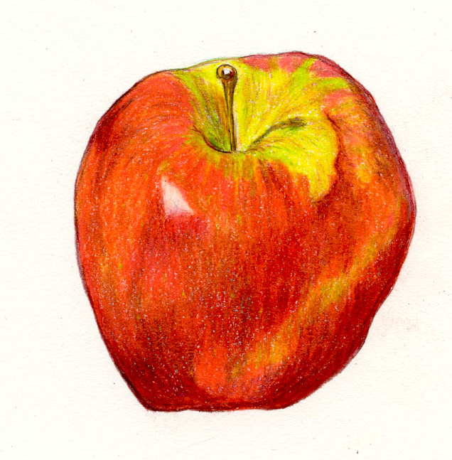
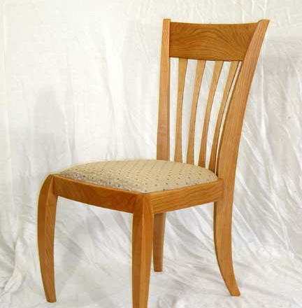
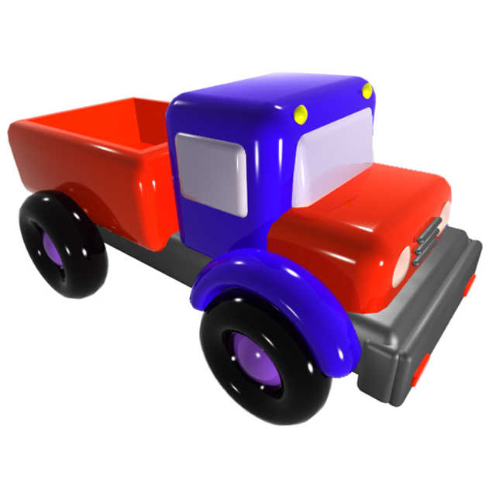
Count nouns
You can place a numeral in front of these!
Refer to objects that are
unique, countable

Slide 10

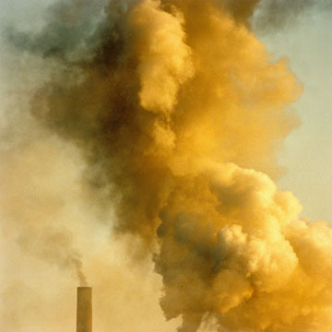
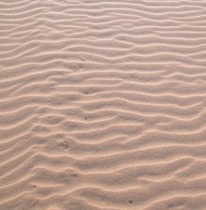
Mass nouns
You CANNOT place a numeral in front of these!
Refer to substances that
have no inherent boundaries

Slide 11
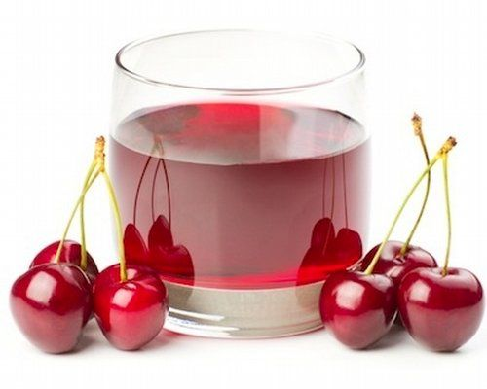
Count vs. mass is language-specific
In Old English, peas and cherries were singulars
Mass nouns can be singular only
Russian kartofel’ ‘potato’, vinograd ‘grapes’, višnja ‘cherries’, izjum ‘raisins’, klubnika ‘strawberries’, kljukva ‘cranberries’, malina ‘raspberries’, morkov’ ‘carrot’
Mass nouns can be plural only
Russian šči ‘cabbage soup’, slivki ‘cream’, oboi ‘wallpaper’
N. Saami uses singular vs. plural to distinguish wet vs. dry for masses
Singular deadja ‘tea (the drink)’ vs. Plural deajat ‘tea (dry leaves)’
Generalization:
The smaller the individuals, the more likely it is a mass noun.
Flour vs. furniture

Slide 12
Mass nouns and numeral (noun) classifiers
In some languages, all nouns are “born” as mass nouns
Dictionary contains only mass nouns, e.g., Yucatec Mayan
In order to create count nouns, you add a marker:
Such markers are known as “numeral classifiers”
Sort nouns into classes according to shape
Obligatory in some contexts (e.g., with numerals)
‘un-tz’íit kib’ | [one long-thin wax] | ‘one candle’
‘un-tz’íit che’ | [one long-thin wood] | ‘one stick’
‘un-tz’íit nal | [one long-thin corn] | ‘one ear of corn’
‘un-tz’íit há’as | [one long-thin banana] | ‘one fruit of the banana’
‘un-wáal há’as | [one flat banana] | ‘one banana leaf’
‘un-kúul há’as | [one planted banana] | ‘one banana tree’

Slide 13
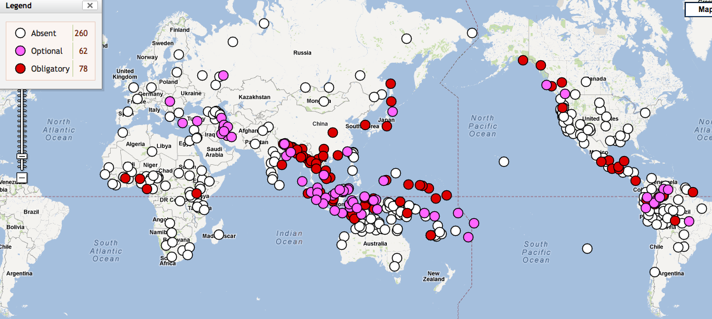
Numeral Classifier Systems Worldwide
Source: The World Atlas of Language Structures Online, wals.info

Slide 14
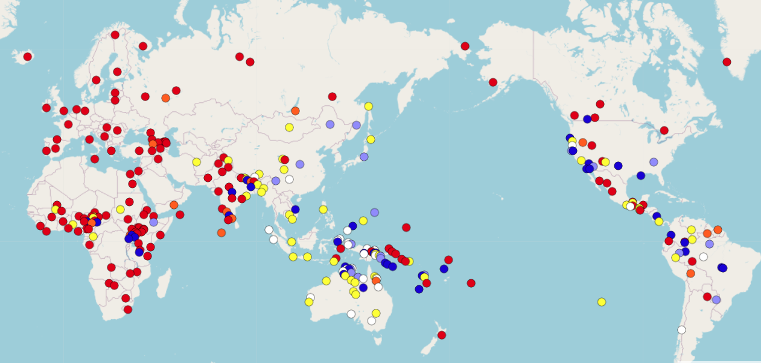
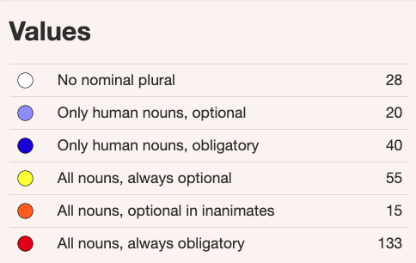
Let’s turn to animacy and definiteness!
WALS: Occurrence of Nominal Plurality
A: Animacy and definiteness interact with plurality
Q: Why are there so many values?

Slide 15
Questions and Comments?
Clip: Conlanging 1:07:32-1:10:44

Slide 16
The animacy hierarchy: different languages cut it up differently
●male human
●human
●animate
●discrete, concrete, manipulable
●concrete non-manipulable, locations
●substances
●abstractions
HIGH
LOW
Items higher on the animacy hierarchy are usually more likely to be pluralizable.

Slide 17
Animacy in Russian: native speakers aren’t sure!
Animate
Inanimate
Plants
Objects
Substances
Corpses
Humans
Dead people
Animals
Different endings in the accusative:
Ja znaju jazyk ‘I know a language’
Ja znaju student-a ‘I know a student’
Variable
Bacteria, viruses
Sea creatures
Embryo
Dolls, snowmen

Slide 18
Definiteness
The speaker assumes that the addressee knows which item s/he is talking about.
What is the difference in meaning?
Indefinite: I read a book.
Definite: I read the book
Indefiniteness might or might not be compatible with plural
French des livres vs. English books [not *a books]
Indefinite marking might be incompatible with mass nouns
water, grass, fire (NOT: «a water» etc.)
Lots of options for your conlang!

Slide 19
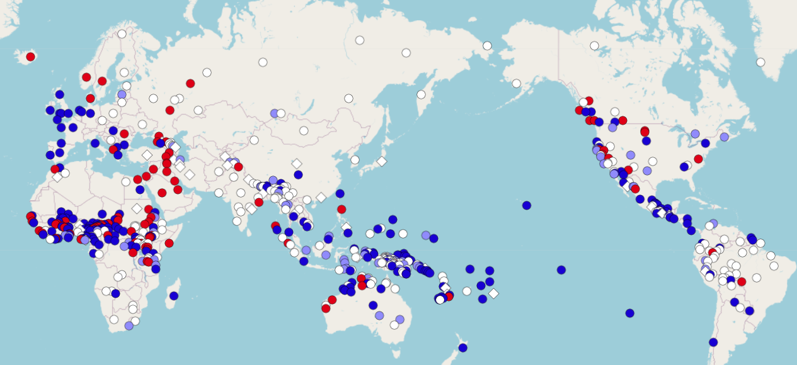
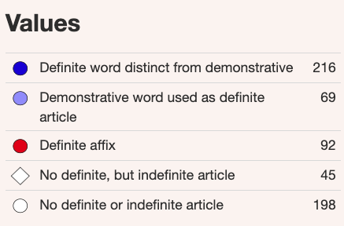
Definiteness

Slide 20
Questions and Comments?

Slide 21
Grammatical gender
Add the correct definite articles in German:
_____ Freund ‘the (male) friend’
Der
_____ Freundin ‘the female friend’
Die
_____ Auto ‘the car’
Das
Why different articles?
German has three groups of nouns that take different articles
Such groups are called “grammatical genders”
Grammatical genders:
Classes of nouns reflected in the behavior of associated words (e.g., articles)
(Definition by Charles Hockett)

Slide 22
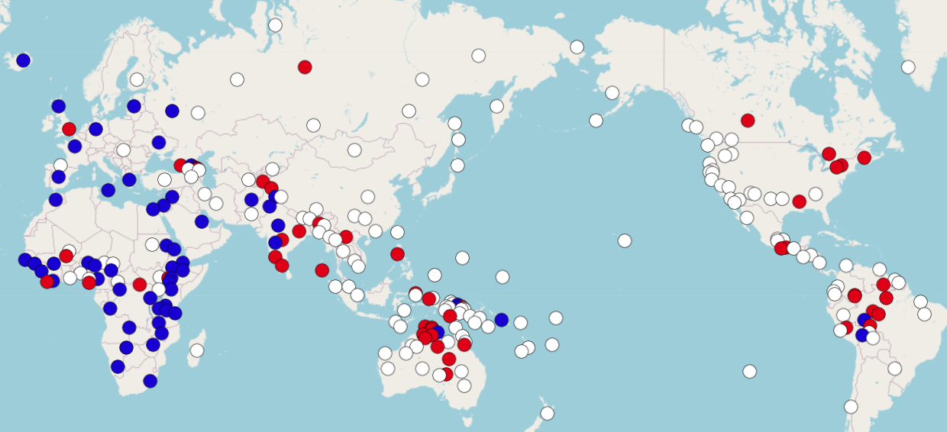
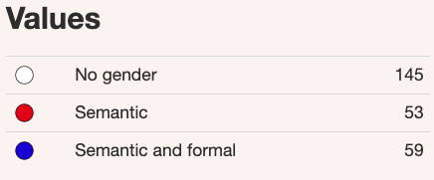
Feature 32A: Systems of Gender Assignment

Slide 23
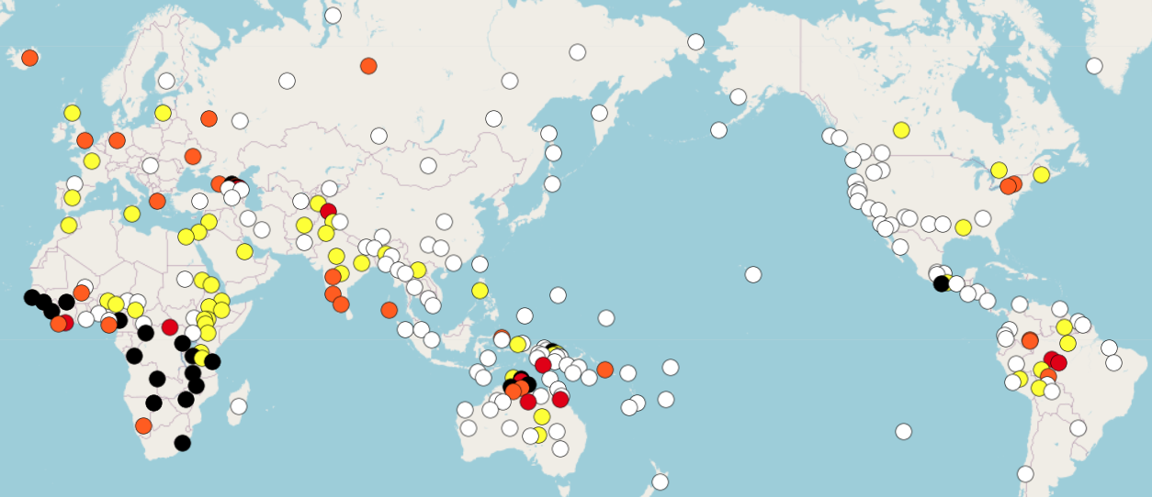
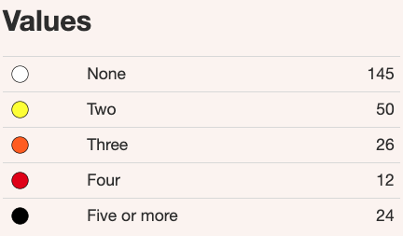
Feature 30A: Number of Genders

Slide 24
Grammatical gender
Some languages have no grammatical gender at all
Finnish, N. Saami
Some languages have “semantic” gender (gender determined by word meaning): sex-based
Many languages use gender to group nouns: noun classes
Gender systems tend to interact with animacy
When gender is grammatical, it can be marked on: pronouns, nouns, adjectives, verbs, etc. (or some subset of these)

Slide 25
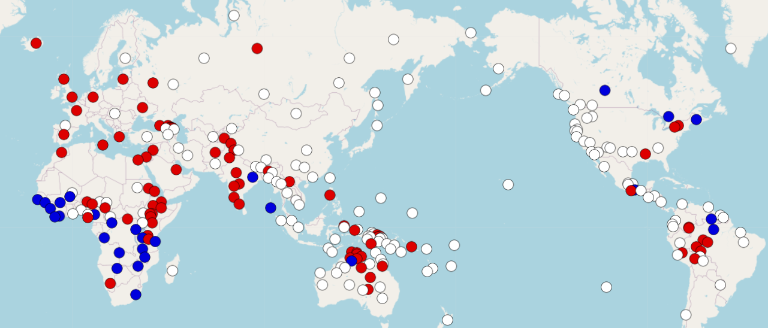
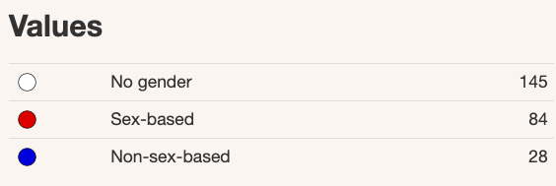
Feature 31A: Sex-based and Non-sex-based Gender Systems

Slide 26
A gender system can classify nouns
David Peterson’s classification (p. 118):
Humans who love lentils
Useless humans
Lamps or things that could be confused for lamps
Objects that cats consider chairs
Spoons that have been bent trying to scoop ice cream
Cats and regular spoons
Animals that cats believe to be divine (i.e. cats)
Animals cats hold in disdain (i.e. all other animals)
Rainbows, gems, unicorns, and other objects depicted on Trapper Keepers
Celestial phenomena (not stars)
Stars, birds, cooking pots, and certain types of treasure
Everything else

Slide 27
Questions and Comments?
Clip: Conlanging 43:54-46:40

